Slide 1




HOTEL RESERVATION ANALYSIS WITH SQL
BY ANUSHKA MATHUR
BATCH NAME : MIP-DA-10
PROFILE - DATA ANALYST INTERN

Slide 2


Contents
01
Introduction & Overview
05
Insights
02
Problem Statement
06
Qualitative Analysis
03
Dataset
07
Suggestions & Market outcomes
04
Discussion & Codes
08
Conclusions

Slide 3

Hello!
Warm greetings to all. Have you ever thought about when to book a hotel room in the year? Or is it the best time to stay for the best daily rate? What if you want to predict whether the hotel may receive too many special requests? The Hotel Reservation dataset can help you explore these issues. I am going to introduce & Analyse a Hotel reservation dataset, which aims to address key challenges and capitalize on emerging opportunities in the market.

Slide 4
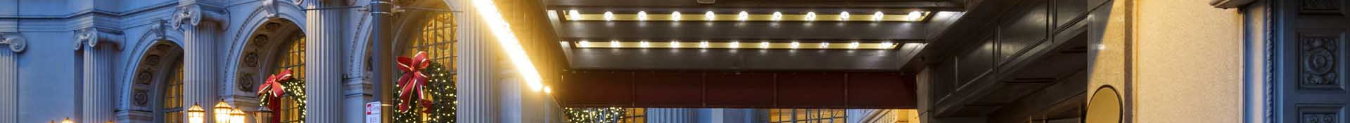
OVERVIEW
The more technology hotels use, the more data becomes available to them. For Hotel property owners & sales managers, these metrices are so valuable. Unearthing useful insights from the vast amount of hotel data at your disposal is always going to be on-going and somewhat time-consuming but it doesn't have to be as complicated as it seems. By focusing your efforts on specific data sets and getting creative with how you use them, data analysis will prove to be an actionable and transformative tool for your hotel. The overall goal of data analysis is to track patterns at your property and set yourself up to make accurate predictions. In turn you can plan and strategies towards your ultimate desire: increased revenue.
When you learn to Organize, Analyze, & apply the right hotel data, you can:-
Create a better experience for guests.
Book more rooms & group events
Outsmart your competition
Grow your bottom line

Slide 5




Problem Statement
You are tasked with analyzing a Hotel Reservation Dataset using SQL. Here are 15 Questions for which you will be writing SQL queries to gain meaningful insights.
Scope of the Study
Our study aims to pinpoint challenges and opportunities, assess feasibility, and offer strategic insights.
Relevance of the Study
Understanding its market implications is crucial for businesses aiming to stay competitive and meet evolving customer needs.
Research Question
How can a new stategy effectively address the market needs, leverage market trends, and differentiate itself in the competitive landscape?

Slide 6

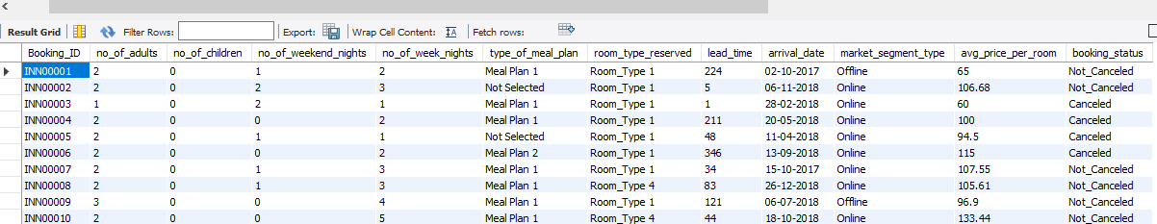

DATASET
Showcasing the dataset. Gives us a clear view about how many columns does the dataset contain.

Slide 7

COLUMN NAME | DESCRIPTION
Booking_ID | A unique identifier for each hotel reservation
no_of_adults | The number of adults in the reservation
no_of_children | The number of children in the reservation
no_of_weekend_nights | The number of nights in the reservation that fall on weekends
no_of_week_nights | The number of nights in the reservation that fall on weekdays
type_of_meal_plan | The meal plan chosen by the guests
room_type_reserved | The type of room reserved by the guests
lead_time | The number of days between booking & arrival
arrival_date | The date of arrival
market_segment_type | market_segment_type
avg_price_per_room | The average price per room in the reservation
booking_status | The status of the booking

Slide 8

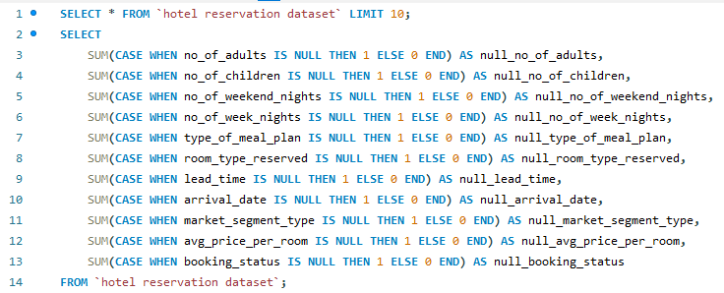
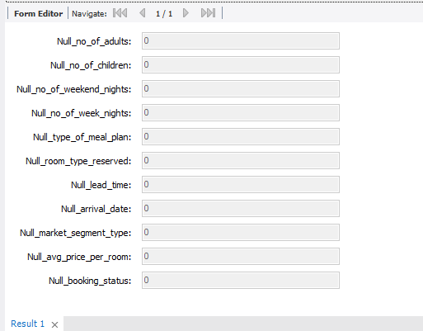
DISCUSSIONS & CODE
Checking NULL Values :
NULL values are those values in which there is no data value in the particular field in the table.
It is important to understand that a NULL value differs from a zero value.
A NULL value is used to represent a missing value, but it usually has one of three different interpretations:
The value unknown (value exists but is not known)
Value not available (exists but is purposely withheld)
Attribute not applicable (undefined for this tuple)
It is often not possible to determine which of the meanings is intended. Hence, SQL does not distinguish between the different meanings of NULL.

Slide 9
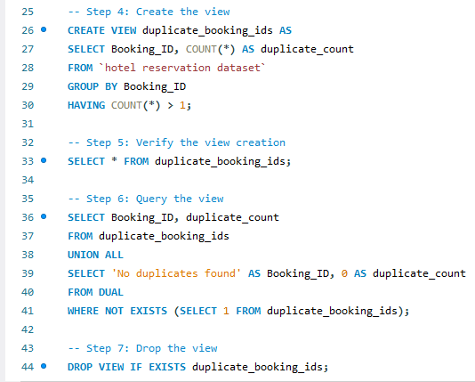
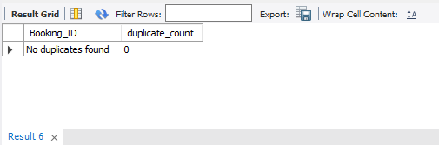
DISCUSSIONS & CODE
Checking DUPLICATE Value :
Duplicate records in SQL, also known as duplicate rows, are identical rows in an SQL table. This means, for a pair of duplicate records, the values in each column coincide.
It is important to check duplicate values so that the dataset remains original & unique.
From the output we got to know that there are no duplicate values in the dataset
How did we come to this conclusion?
We created a view named duplicate_booking_ids. A view in SQL is a virtual table based on the result set of an SQL query. It contains rows & columns just like a table & the fields in a view are fields from one or more real tables in the dataset.

Slide 10
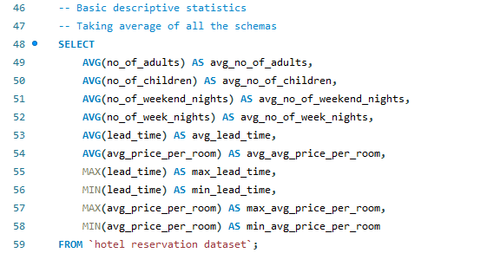
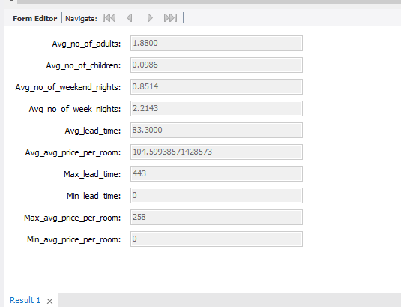
DISCUSSIONS & CODE
Computing AVERAGE Values
Taking Average of all the schemas is essential for predicting the approximate averages of a particular field. This comes under basic analytics.
Average or arithmetic means give us rough estimate about the common values in that set so that the calculations on all the values will be more or less the same.
Averages can provide a simple summary of large amounts of data.
Averages can help you identify trends and patterns in data, and look past random fluctuations to see the central trend.
Averages can be useful for comparing different quantities of the same category.
Understanding how to find averages can help you make better business decisions.

Slide 11
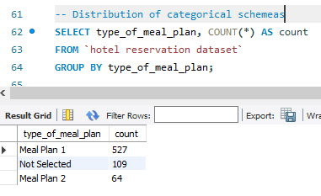
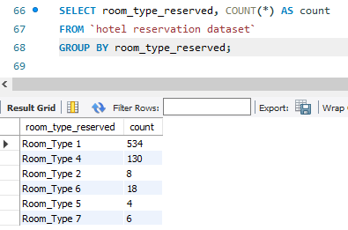
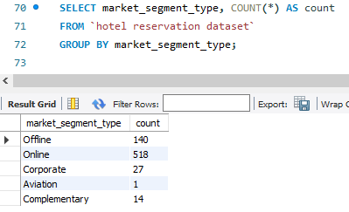
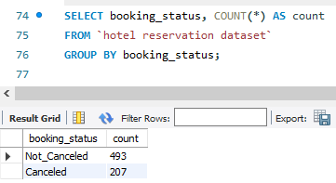
SOME MORE PREREQUISITES
CHOICE OF ROOM TYPE
CHOICE OF MEAL PLANS
CHOICE OF MARKET SEGMENT
CHOICE OF BOOKING STATUS

Slide 12
QUESTIONS
How many reservations fall on a weekend (no_of_weekend_nights > 0)?
11
What is the average number of weekend nights for reservations involving children?
What is the total number of reservations in the dataset?
06
01
12
How many reservations were made in each month of the year?
02
Which meal plan is the most popular among guests?
07
What is the highest and lowest lead time for reservations?
What is the average price per room for reservations involving children?
13
What is the average number of nights (both weekend and weekday) spent by guests for each room
type?
03
08
What is the most common market segment type for reservations?
How many reservations were made for the year 20XX (replace XX with the desired year)?
For reservations involving children, what is the most common room type, and what is the average
price for that room type?
04
14
09
How many reservations have a booking status of "Confirmed"?
05
15
Find the market segment type that generates the highest average price per room.
What is the most commonly booked room type?
What is the total number of adults and children across all reservations?
10

Slide 13

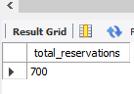
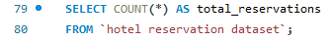
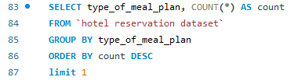
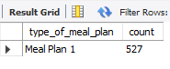
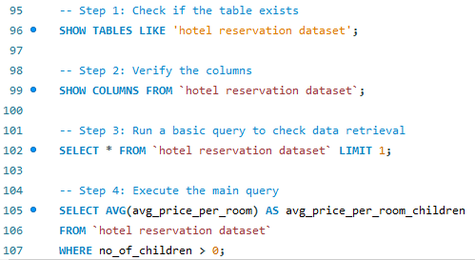
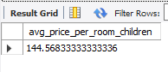
ANSWERS & CODE
Q1. What is the total number of reservations in the dataset?
Q2. Which meal plan is the most popular among guests?
Q3. What is the average price per room for reservations involving children?

Slide 14
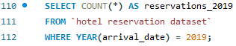
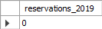
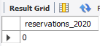
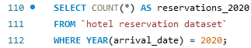
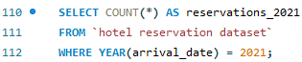
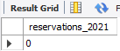
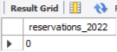
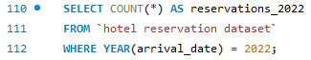
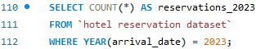
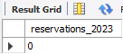
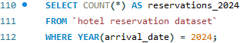
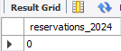
ANSWERS & CODE
Q4. How many reservations were made for the year 2017-18 ?
From querying these we have come to a conclusion that there are no fields in the dataset which contain years including 2019, 2020, 2021, 2022, 2023, 2024 so we have checked further years.

Slide 15
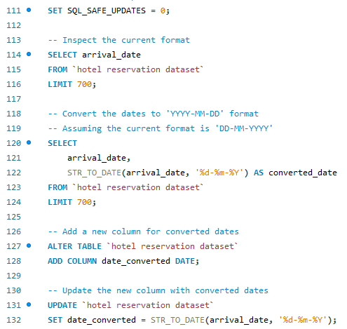
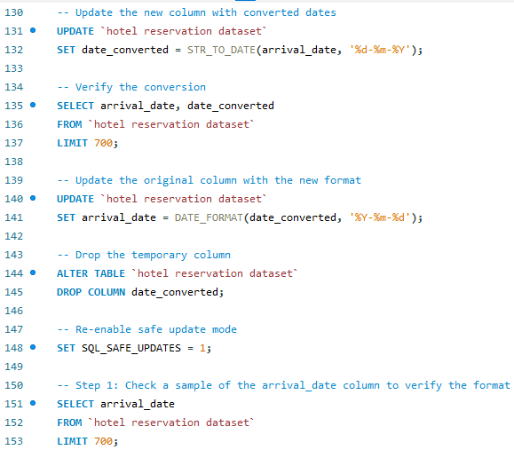
ANSWERS & CODE
Q4. How many reservations were made for the year 2017-18 ?

Slide 16
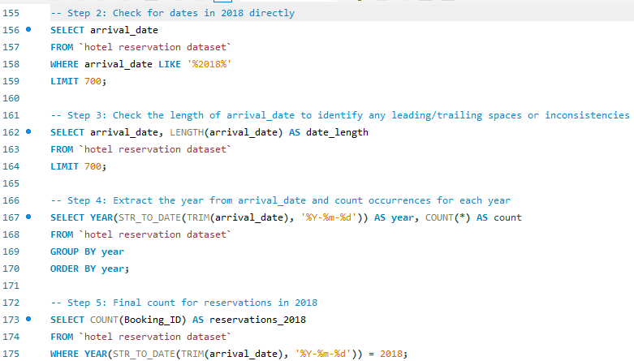
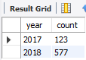
ANSWERS & CODE
Q4. How many reservations were made for the year 2017-18 ?

Slide 17
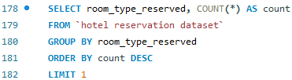
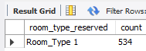
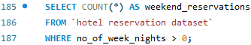
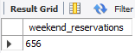
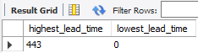
ANSWERS & CODE
Q5. What is the most commonly booked room type?
Q6. How many reservations fall on a weekend (no_of_weekend_nights > 0)?
Q7. What is the highest and lowest lead time for reservations?

Slide 18
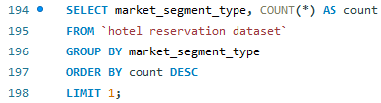
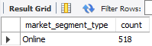
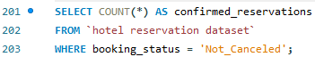
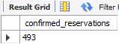
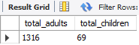
ANSWERS & CODE
Q8. What is the most common market segment type for reservations?
Q9. How many reservations have a booking status of "Confirmed"?
Q10. What is the total number of adults and children across all reservations?

Slide 19
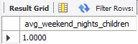
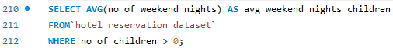
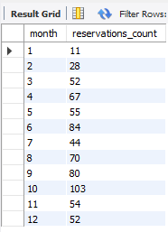
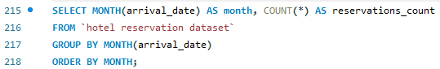
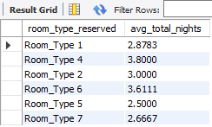
ANSWERS & CODE
Q11. What is the average number of weekend nights for reservations involving children?
Q12. How many reservations were made in each month of the year?
Q13. What is the average number of nights (both weekend and weekday) spent by guests for each room type?

Slide 20
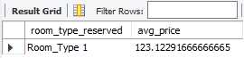



ANSWERS & CODE
Q14. For reservations involving children, what is the most common room type, and what is the average
price for that room type?
Q15. Find the market segment type that generates the highest average price per room.

Slide 21

INSIGHTS
We have gained usefull insights from that should be maily highlighted before proceeding to the Qualitative Analysis
Meal plan-1 is the most popular.
There have been more reservations in 2018 as compared to 2017.
Most commonly booked room type is room type 1
Most common market segment is online.
October was the month where most bookings were made.
Online is the most preferred market segment that generates the highest revenue.

Slide 22


Qualitative Analysis
The analysis of the dataset encompasses a comprehensive examination of the market landscape, consumer insights, competitive dynamics, feasibility considerations, and strategic recommendations.
Some of the recommendations are as follows :
As Meal plan -1 is the most loved the Quality of meal plan 1 should be of utmost priority.
What led to the downfall in 2017 & what improved in 2018 then?
Quality of room type one should be of utmost importance.
What offer or scheme attracted most customers in the month of October?
As online is the most preferred we should ensure customer friendly user Interface for our websites & apps.

Slide 23

SUGGESTIONS
MARKET OUTCOME
Through a deep dive into market trends, consumer preferences, and competitor strategies, the proposal aims to identify opportunities, challenges, and potential pathways for success.
Some suggestions are as follows :-
While computing averages we found that there are less number of people with children who are visiting. So we can introduce special offers for children like playrooms, gaming rooms etc.
Meal plan 2 & room types except room type 1 should be analyzed for detecting loopholes.
Enhancing the UI Interface for advancing online segment along with analyzing what other segments lack.
Determine the most occuring common reasons for cancellation of booking.
Introduce other meal plans & discuss how to make them different and versatile
Analyze what the competitors have better than us & realizing our scope of improvement
Curating a planned way to be one step ahead in advertising.
Understanding the strengths & weaknesses of our competitors.

Slide 24
CONCLUSION
The analysis of the hotel reservation dataset reveals valuable insights for informed decision-making in the hospitality industry. Understanding guest preferences, popular meal plans, room types, booking trends, and market segments allows hotels to tailor their offerings, optimize pricing strategies, and enhance the guest experience. leveraging data-driven insights empowers hotels to stay competitive, attract the right audience, and drive business success.
This project has provided me with hands-on experience in utilizing SQL for real-world data analysis, focusing on Hotel Reservation Dataset. I have attempted to clean data & apply SQL functions effectively to draw insights.

Slide 25

Thank You!

